Slide 1

NJ UNEMPLOYMENT BENEFITS
WHAT YOU NEED TO KNOW

Slide 2
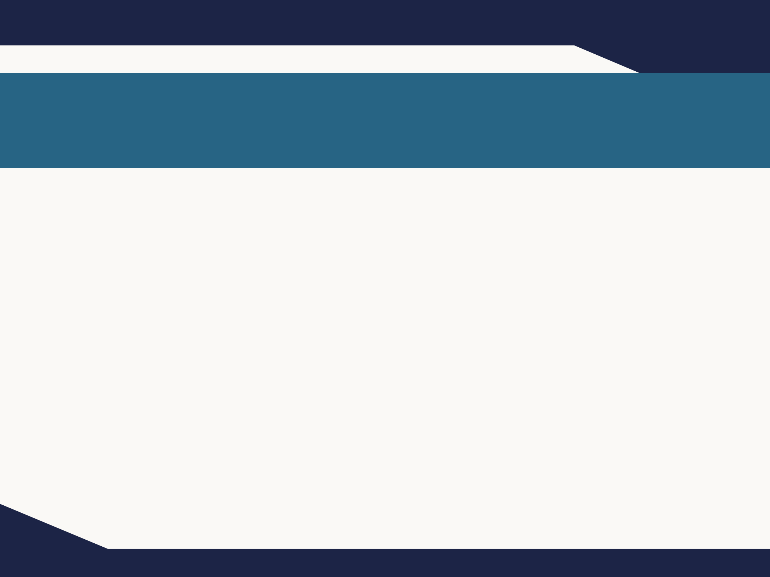

LEGAL DISCLAIMER
This presentation is intended as general information and not legal advice.​
The NJ Register and the NJ Administrative Code remain the official sources for regulatory information published by the NJDOL.

Slide 3
WHAT IS UNEMPLOYMENT INSURANCE?
Unemployment Insurance (UI) is a program that gives financial support to people who lose their jobs or whose work hours are reduced through no fault of their own.
Those who meet eligibility requirements may receive benefits for up to 26 weeks during a one-year period. During times of high unemployment, other extended benefit programs may be available.
Receive 60% of your average weekly wages, up to a maximum amount.
Requires a valid Social Security Number to receive benefits.

Slide 4
WHO IS ELIGIBLE FOR BENEFITS?
When you first apply for Unemployment Insurance benefits, NJDOL reviews information you and your employer(s) provide.
To qualify, you must meet all of the eligibility requirements of federal and state unemployment compensation laws and regulations. There are two main categories of eligibility:
Monetary – claimants must earn a certain amount of money during their “base period” to be eligible for benefits.
Non-Monetary – claimants must have lost their job or had a reduction in work hours due to no fault of their own.

Slide 5
WHO IS ELIGIBLE FOR BENEFITS? continued
After you first qualify for benefits each week you must be
able to work
actively seeking work
available for work
and not refuse an offer of suitable work
You must also keep your appointments with NJDOL when scheduled in order to continue receiving them.

Slide 6
WHY ARE YOU UNEMPLOYED?
Unemployment Insurance benefits are meant for people who lose their job “through no fault of their own,” such as an employer’s lack of work or a layoff due to downsizing.
If you were fired due to misconduct or you quit voluntarily without good cause related to the work, your benefits may be denied or require a waiting period. In these cases, NJDOL will review your eligibility:
An NJDOL representative will conduct a fact-finding by phone or email.
Employer may be asked to participate

Slide 7
EARNINGS REQUIREMENTS
You have to meet a minimum earnings requirement during your base year. The base period is the timeframe used to determine if you qualify for UI benefits and to calculate your benefit amount. There are multiple ways we calculate a base year.
See the current year’s earnings requirements at myunemployment.nj.gov.
Even if you do not think you meet earnings requirements, we still recommend you apply.
Must meet definition of an employee; properly classified independent contractors are not eligible. Learn more about worker misclassification at myworkrights.nj.gov

Slide 8
WORK AUTHORIZATION
Workers must have valid work authorization:
(1) during the base period;
(2) at the time that they apply for benefits and;
(3) for any period for which they are claiming benefits (otherwise they are not available for work).

Slide 9
HOW YOU’LL BE PAID
When you file a new claim, you can choose how you want to receive your benefits: direct deposit or a prepaid debit card.
If you don't enter your banking information to sign up for direct deposit, you will get your benefits by prepaid debit card.
Learn more at myunemployment.nj.gov/payment.

Slide 10
UNIQUE ELIGIBILITY REQUIREMENTS
There are unique eligibility requirements for the following types of employment:
Teachers & School Employees
Corporate Officers & Business Owners
To learn more, visit myunemployment.nj.gov/eligibility.

Slide 11
LIVE AND WORK IN DIFFERENT STATES?
You generally must apply for benefits in the state that you worked in the past 18 months.
Exceptions for military service
Learn more at myunemployment.nj.gov/outofstate

Slide 12
HOW TO APPLY
We recommend you apply online at myunemployment.nj.gov.
You can apply online in English and Spanish.
To apply by phone in English or Spanish, call (732) 761-2020. For other languages, choose to speak with an agent and request an interpreter.

Slide 13
VERIFYING YOUR IDENTITY
You will be instructed to verify your identity through a specific weblink connected to ID.me.
The process can be completed in a few minutes using the email address associated with your initial unemployment claim, a computer or mobile phone, and common pieces of identification documents.
You can also complete the process via a live video conference session in the language of your choice.
You can also schedule an in-person appointment.
Learn more at myunemployment.nj.gov/identity.

Slide 14
CERTIFYING FOR BENEFITS
You must certify for benefits each week you wish to receive benefits.
When you certify, you are confirming that you were able and available for work the entire week.
You certify for benefits after the week has passed.
You can certify Sunday through Friday at 8am to 7pm.
If you do not certify for 28 days your claim will be closed and you will need to reopen the claim. You may not receive benefits for the weeks in which you do not certify.

Slide 15
FIRST TIME CERTIFYING?
Your claim is dated the Sunday of the week in which you filed your initial claim. The first time you claim benefits will be on a Wednesday, 17 days after your date of claim.
The first time you certify you'll need to create a 4-digit PIN after entering your Social Security number.
Remember your PIN—You'll need it to certify each week.
Visit myunemployment.nj.gov/certify to certify online.
If you can’t certify online, visit myunemployment.nj.gov/contactus to find the right phone number.

Slide 16
CERTIFICATION QUESTION: WERE YOU ABLE AND AVAILABLE TO WORK?
The answer to this question should be YES if you are physically and mentally able to work and you are available to report to work.
Being available for work means that you must be ready to start work immediately. This includes having transportation access and no personal reasons that prevent you from working. You must have any valid work authorization necessary.
You will not receive benefits during any week in which you are unavailable for work. For instance, if you are on vacation or traveling for a week or more, you won't be able to receive Unemployment Insurance benefits during that time.
If you are not able and available to work your answer should be NO.

Slide 17
CERTIFICATION QUESTION: WERE YOU ACTIVELY SEEKING WORK?
If you actively searched for work, you should answer YES. Telephone, internet and in-person contacts, as well as sending resumes, are all acceptable work search activities.
Otherwise, your answer should be NO.
Learn more at myunemployment.nj.gov/worksearch
Keep a written record of all of your work search activities. You need a minimum of 3 per week.
You must be able to show this to the NJDOL if asked.

Slide 18
JOB SEARCH & TRAINING OPPORTUNITIES
Learn about NJDOL’s free career services at: nj.gov/labor/career-services

Slide 19
CERTIFICATION QUESTION: DID YOU REFUSE ANY WORK?
If you did refuse an offer of work, you should answer YES UNLESS the work you declined was not suitable work
The definition of a "Suitable Job" is fitted to each person, depending on where they live, their skills, experience and past salary.

Slide 20
CERTIFICATION QUESTION: WERE YOU ATTENDING SCHOOL OR JOB TRAINING?
If you are attending school or training, answer YES. Otherwise, your answer should be NO.

Slide 21
CERTIFICATION QUESTION: DID YOU RECEIVE HOLIDAY OR VACATION PAY?
If you received holiday or vacation pay, answer YES. We will send an e-Adjudication link to determine if it should be reported as earnings. If not, your answer should be NO.

Slide 22
CERTIFICATION QUESTION: ARE YOU RECEIVING OR HAVE YOU APPLIED FOR A PENSION OR OTHER RETIREMENT PAY?
You should answer YES if you are currently receiving pension or other retirement benefit payments from a listed employer.
Answer NO if:
You are not receiving pension payments
You are receiving pension from an employer who is not listed

Slide 23
CERTIFICATION QUESTION: DID YOU WORK BETWEEN MM-DD-YYYY AND MM-DD-YYYY?
If you did any work (or received any payment for any completed past work) between the designated dates, answer YES and report hours worked and your gross wages.
Report wages from an employer the week they were earned; report self-employment income the week it was received.

Slide 24
PROBLEM WITH YOUR CLAIM? STILL CERTIFY
If you are resolving a problem with your claim or appealing a denial, you must still certify for benefits.
You can receive "credit" for the weeks you certify for. If determined eligible or you win your appeal, you will be paid benefits for your credited weeks.
If you have not certified for benefits and you win your appeal, you will not be paid for these weeks.

Slide 25
APPOINTMENTS, FACT-FINDING HEARINGS, AND E-ADJUDICATION
You may be required to participate in mandatory scheduled appointments.
These may be done over the phone, online via a secure form linked from an email we send, or in person.
If you miss an in-person or phone appointment or don't complete an online form, your benefits may be delayed or denied.
Learn more at myunemployment.nj.gov/factfinding

Slide 26
FILE AN APPEAL
NJDOL will mail you a determination letter if your claim is not approved. If you disagree, you have the right to file an appeal.
Claimants have 21 days to file an appeal to the Appeal Tribunal after an initial determination is mailed to their last known address. Employers have seven days to file an appeal after confirmed receipt of a determination.
You can file an appeal online or mail your appeal to NJDOL.
Learn more at myunemployment.nj.gov/appeals

Slide 27
OVERPAID BENEFITS?
You may be required to repay unemployment benefits you received but were not entitled to. You will receive a notice explaining the reason and amount of overpayment.
Overpayments are typically caused when a worker does not report earnings during the time they are receiving benefits.
If you receive an overpayment notice, there are a few options:
Make a payment(s)
Appeal your determination
Request to waive overpayment
Learn more at myunemployment.nj.gov/overpayments

Slide 28
REOPENING BENEFITS
You have one year from the date you file your initial claim to collect the maximum benefits available to you, based on your monetary eligibility. Learn more about maximum benefit at myunemployment.nj.gov/calculate.
If you get benefits for a period of time, then return to work, but become unemployed again, you can reopen your initial claim.
You can also reopen a claim after a period of ineligibility has expired (for example, refusal of suitable work or are fired for misconduct).

Slide 29
DEPENDENCY BENEFITS
If your weekly benefit rate is less than the maximum weekly benefit rate and you have dependents, you may qualify for Dependency Benefits.
For three dependents, the maximum amount is an additional 15% of your weekly benefit amount .
Dependency Benefits will only increase your weekly benefit rate up to the maximum weekly benefit rate.
Learn more at myunemployment.nj.gov/dependents

Slide 30
PAID FAMILY & MEDICAL LEAVE AND UNEMPLOYMENT
Are you unemployed, but no longer able or available for work due to your own physical or mental health condition, pregnancy, need for bonding or caregiving leave?
You may be eligible for Disability During Unemployment or Family Leave During Unemployment benefits.
Learn more at myleavebenefits.nj.gov/unemployed
If you lose your job after taking NJ Paid Family and Medical Leave (TDI/FLI) because your job was not protected under state/federal law– Could be eligible for Unemployment benefits

Slide 31
CONTACT US
Most callers: 732-761-2020
Out-of-State Claims: 888-795-6672 (must call from out-of-state area code)
New Jersey Relay: 7-1-1

Slide 32
IN-PERSON CLAIM SUPPORT
By appointment only:
myunemployment.nj.gov/appointment
For ID.me appointments visit:
myunemployment.nj.gov/identity

Slide 33
TIPS ON APPLYING
Don't wait to file a claim once separated from your job
Online application is available in English and Spanish
Contact the call center to file over the phone in languages other than English and Spanish
View the Claim Status tool for self-service options
Contact UI customer service at 732-761-2020 during the following times: ​
8:00am – 3:00pm, Monday - Friday (except holidays) ​
We recommend calling at 8 am

